Slide 1
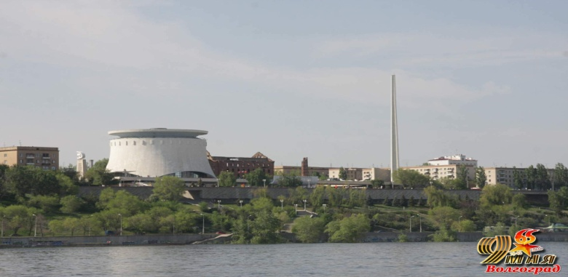
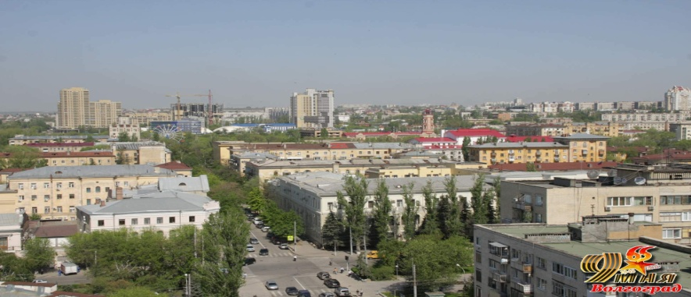

Local development through international relations. Volgograd (Russian federation) experience.

Slide 2
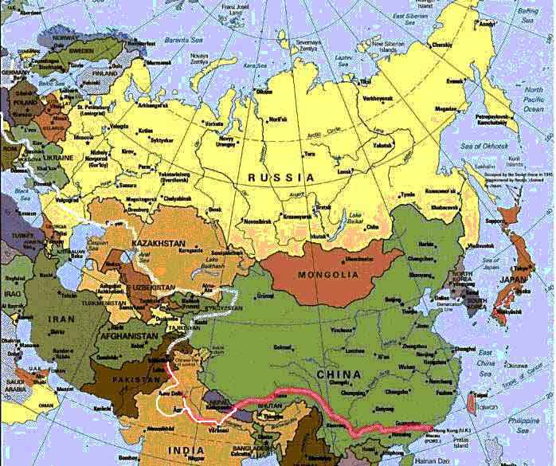
1000 км

Slide 3
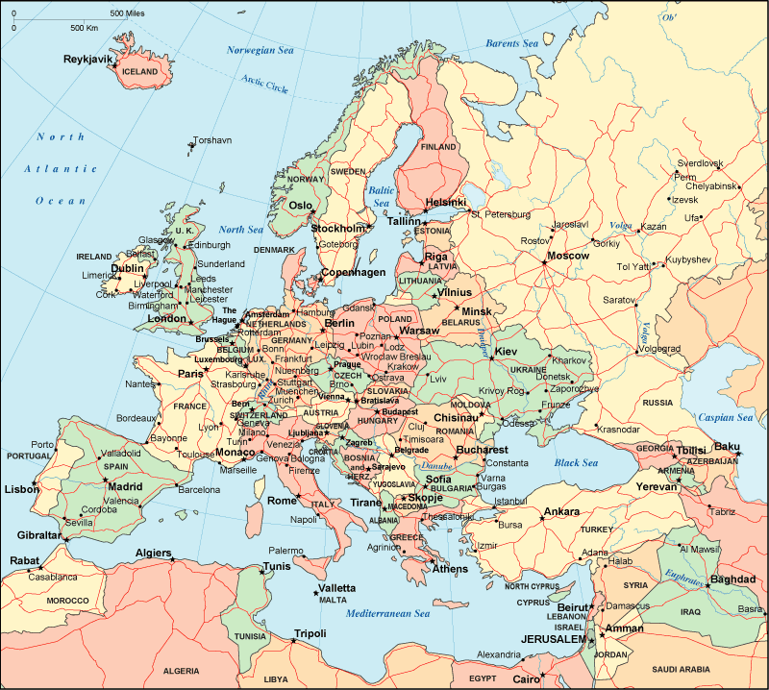
Volgograd-Plonsk 2. 206 кm

Slide 4
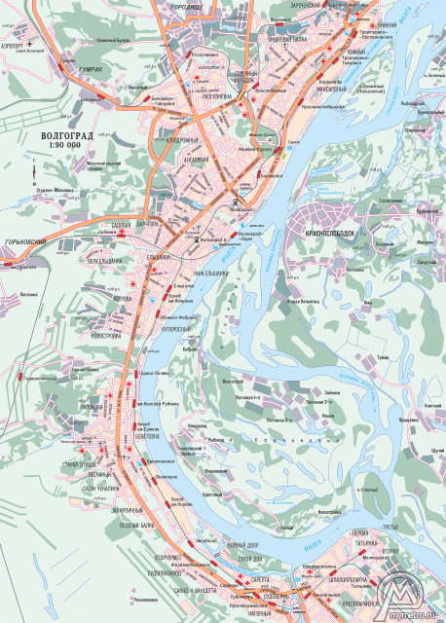
Volgograd city
(Tsaritsin, Stalingrad)
Founded in 1589 as Tsaritsin
In 1925 renamed in Stalingrad
In 1961 renamed in Volgograd
A city is divided into 8 districts
Length 99 km
Area: 56,5 thous. hect.
Population (data 2010)
1 020 862

Slide 5
Resources
inside
outside
Local authorities;
Mass media;
Universities;
Schools, gymnasiums;
NGO’s;
Volgograd Trade of Commerce;
Sister cities;
International organizations, Volgograd is a member of;
International funds and programs;

Slide 6


Twin cities of Volgograd
Coventry , England(1943)
Ostrava, Czech Republic(1948)
Dijon, France(1959)
Kemi, Finland(1959)
Liegue, Belgium(1959)
Turin, Italy(1961)
Port Said, Egypt (1962)
Chennai, India(1967)
Hiroshima, Japan (1972)
Cologne, Germany(1988)
Chemnitz, Germany(1988)
Cleveland, USA (1990)
Chengdu, China(1994)
Jilin, China(1994)
Erevan, Armenia (1998)
Krusevac, Serbia(1999)
Tiraspol, Moldova(2006)
Ruse, Bulgaria(2001)
Izmir, Turkey(2011
Olevano Romano, Italy(2010)
Plonsk, Poland(2008)
Sandansky, Bulgaria (2008)
Maardu Estonia (2008)

Slide 7
International organizations, Volgograd is a member of
World Union of the Cities-Victims, Cities for Peace
World Conference “Mayors for Peace through Solidarity of Cities”
World Organization of United Cities and Local Government
International Association of Peace Messenger Cities;
International Organization «Mayors for Peace»;
Association «International Assembly of Capitals and Large Cities»;
Twin Cities International Association

Slide 8
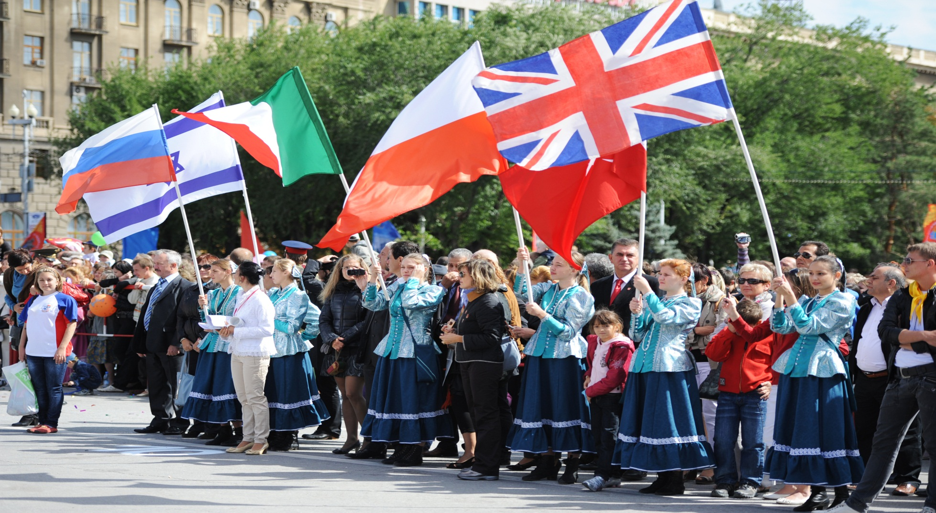
City Day 2011

Slide 9
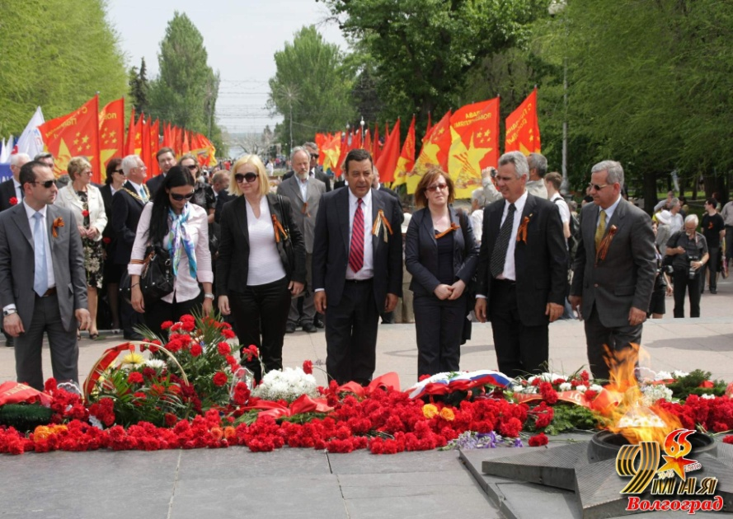
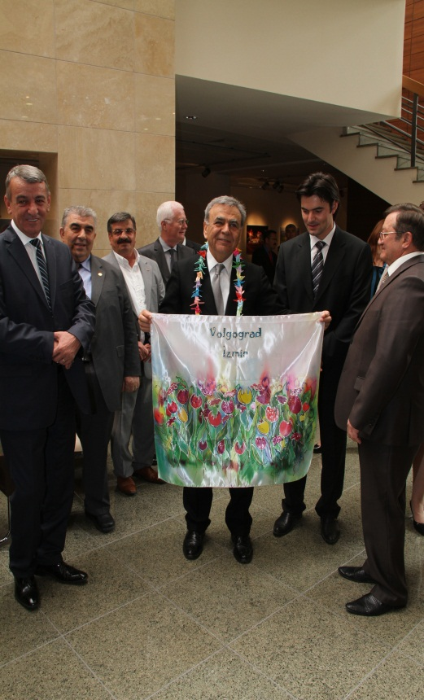
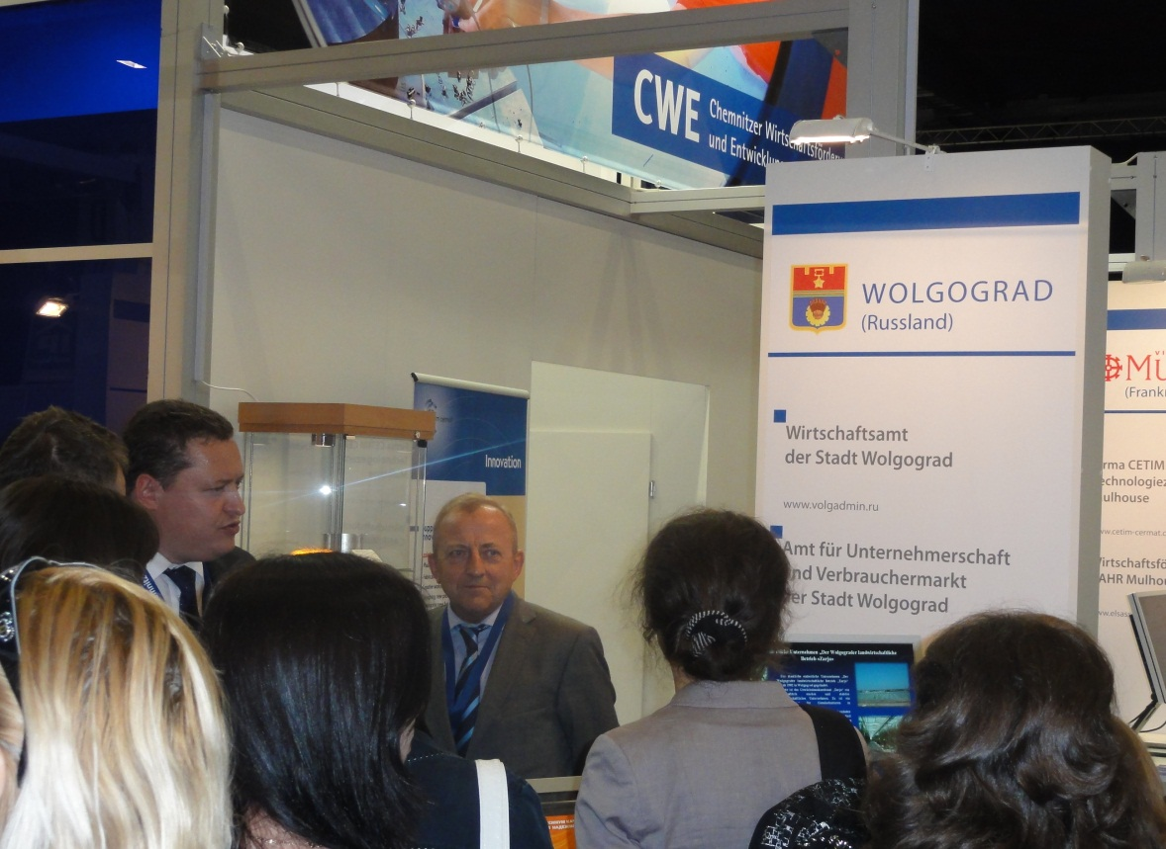
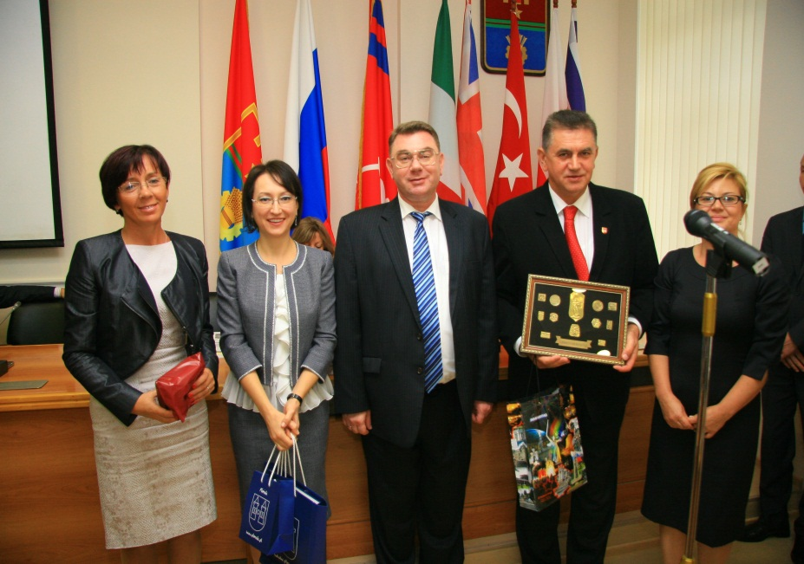
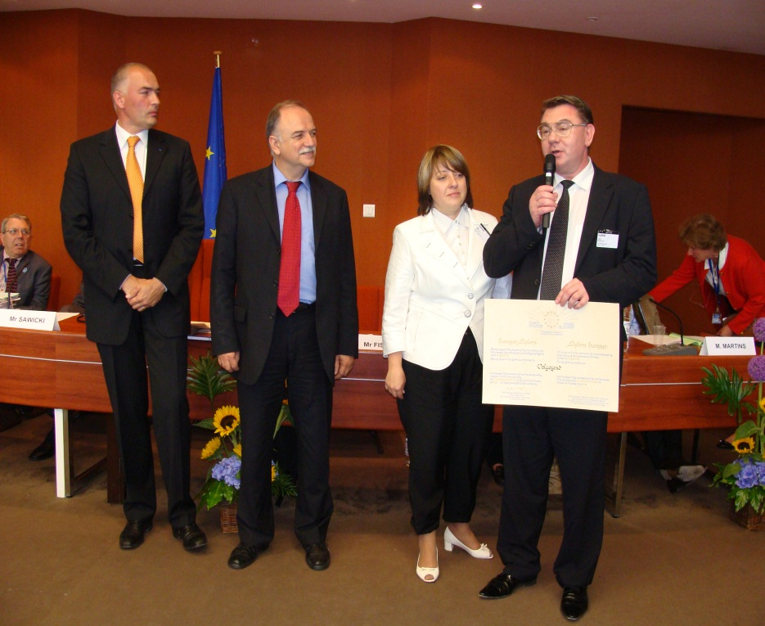

Slide 10
European Prize
Population involvement into the international life of the city
Image of the city
Joint programs with EU-
Twins relations development
-NGO’s development

Slide 11

Volgograd- child friendly city
A Memorandum on cooperation with UNICEF-child friendly city had been signed December ,13,2010
Main goal: child protection in everyday life;
Community involvement ;
Institutes involvement (authorities, NGO’s, associations, business, etc.);
administration, families, professional associations, business-community etc.
Children are taking part in a decision making policy;
Children are important part of the community
Realization:
Strategy of the city development with children interests as the basic point had been approved;
Volgograd Children Council established

Slide 12

Volgograd has joined a WHO initiative “Aged persons friendly city”
Worldwide network
City-members taken commitments to adopt their area for the aged persons; a higher level of comfortability ;
A project is giving an opportunity to find out new decisions to improve the social support and a life quality of the aged persons in the community;

Slide 13

International annual women’s forum “Dialog without borders”

Slide 14
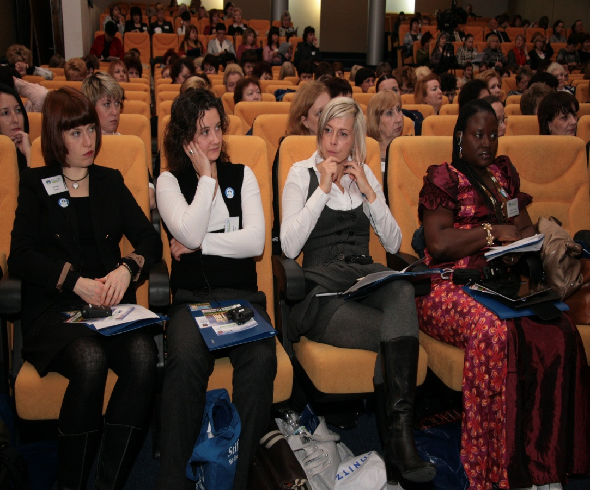
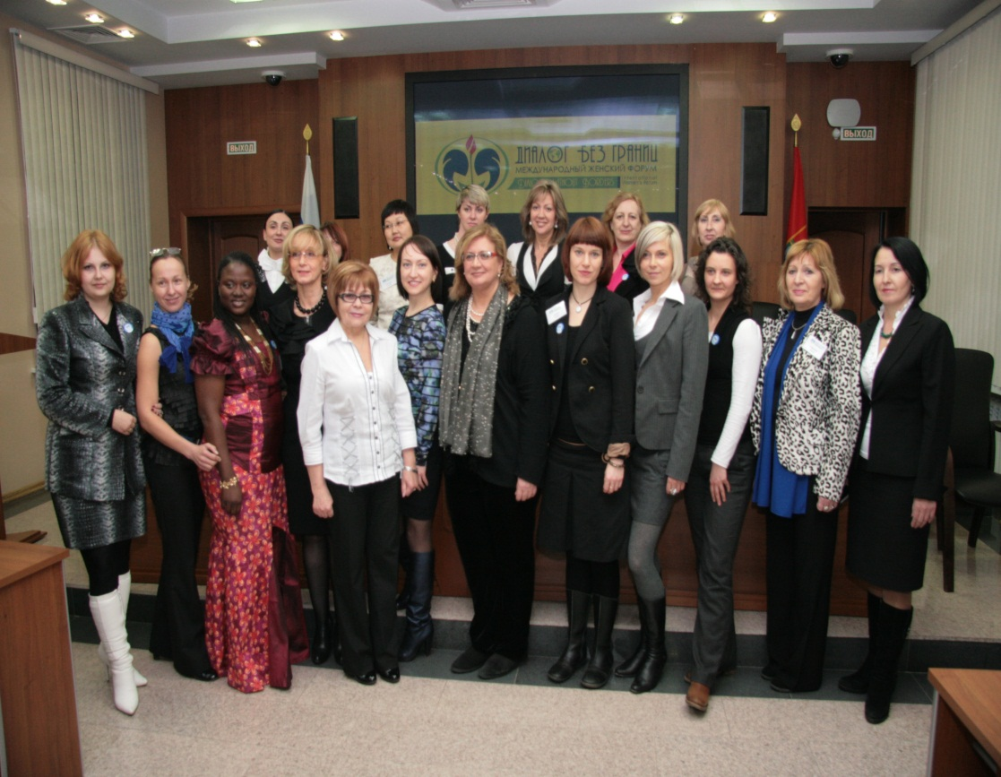






International annual women’s forum “Dialog without borders” (250 participants; 6 countries)

Slide 15

Youth conference for peace in the future in Volgograd, August 17-23
Volgograd hosted 40 young people from 10 foreign countries
Aim of the conference:
To unite youth, to promote peace, solidarity and tolerance
Together with the youth of Volgograd we set up a project “Peace ABC”

Slide 16
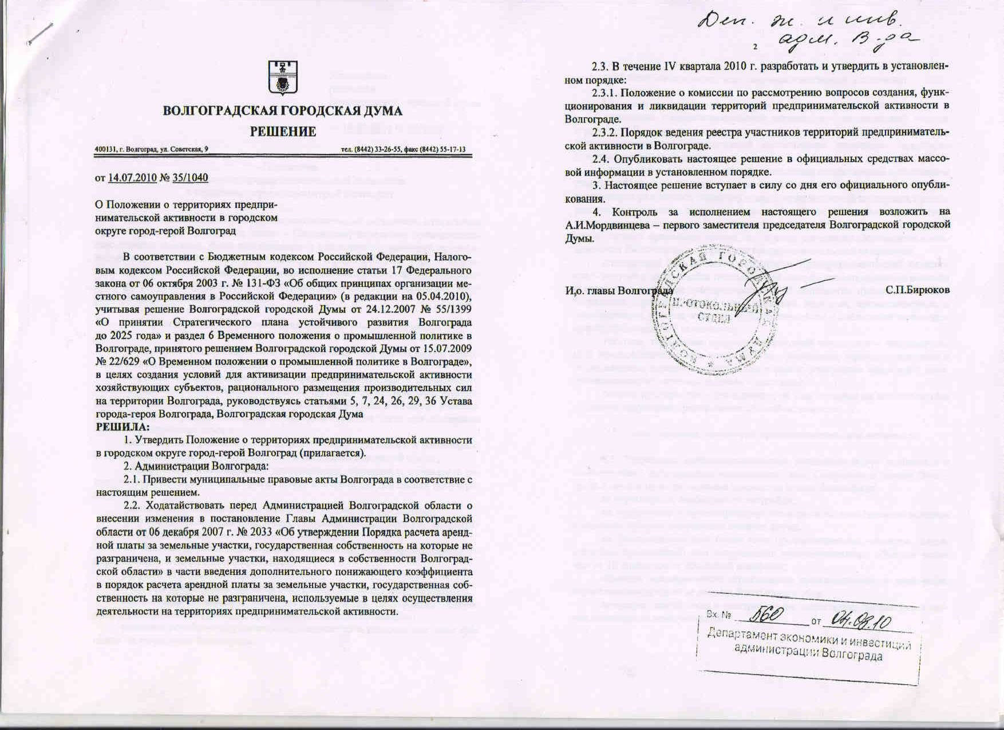
LED. Resources
Mandate of Local Authorities;
Cooperation among local institutes
(authorities, population,
NGO, business);
Promotion of the territory
to attract an outside resources

Slide 17
Cooperation with the city of Plonsk, Poland. Proposal for 2013
Project “School for journalist as a resource to develop solidarity and tolerance”
Aim of the project: promotion of the ideas of solidarity and tolerance through mass media resource among youth of Plonsk and Volgograd
Age of participants: 14-18
Participants:
Experts: two groups of professional journalists (each city per 3 expert)
Two groups of students (journalists) from Plonsk and Volgograd
Aimed auditory : youth from Plonsk and Volgograd
Aims of the project: to teach and to in form through mass media young population from Plonsk and Volgograd about solidarity and tolerance
Budget: travel costs , accommodation and meals for experts. Interpreters expenses.
Mass media publications
Project duration: 12 month

Slide 18
Project “School for journalist as a resource to develop solidarity and tolerance”
Stakeholders:
1. Local authorities
2. Mass Media of Plonsk and Volgograd
3. International, government, local funds
4. Local institutes
5. Associations
6. Business

Slide 19
Project “School for journalist as a resource to develop solidarity and tolerance”
Project stages:
Duration:12 months
1.Preparation( February-March 2013)
( experts selection, students selection, clarification of the youth groups to be involved)
2. Mission 1 (April-may, 2013)
(mission of experts from Plonsk to Volgograd. Duration-7 days; 1st day-workshop with the group of students; 2nd -4th days-interview of youth representatives in Volgograd; 5th day-drafts for the articles; 6th day-bottoms up;7th day-departure)
3. Mission 2 (September-October 2013)
(mission of experts from Volgograd to Plonsk- scheme identical to Mission 1)
4. (June-November 2013)Publications in the articles of news papers and magazines of Plonsk and Volgograd –information exchange
5. December 2013 Teleconference with projects participants ; report ; award ceremony (diplomas)

Slide 20
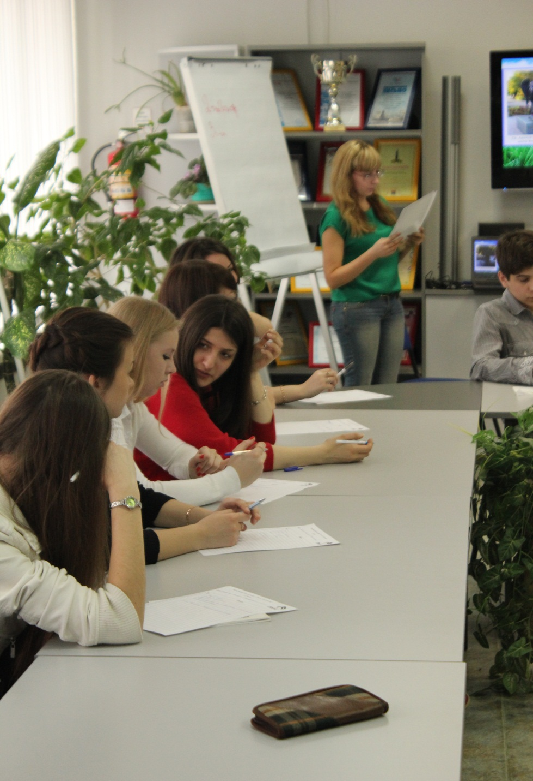
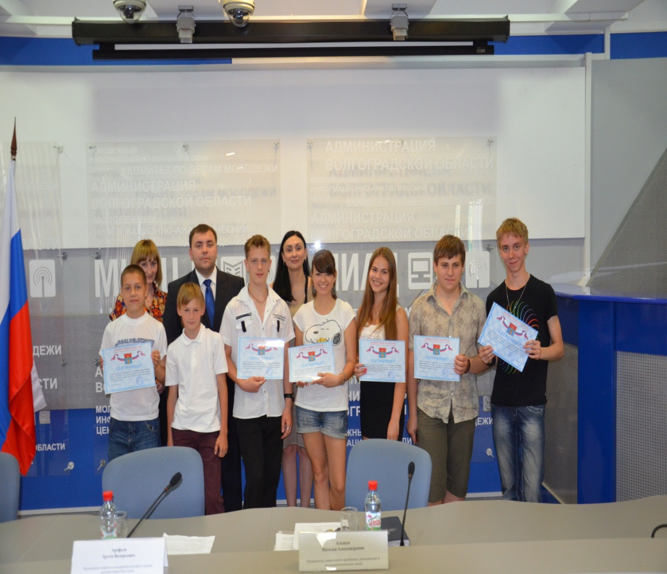
Notes:
Проект с Плонском по обмену молодежью. 2012-2013гг.

Slide 21
Department of international, interregional and external economic relations
Volgograd city municipality tel: 007 8442 30-13-31 fax: 007 8442 30-14-16 www.volgadmin.ru inter@volgadmin.ru

